Slide 1


Handwritten
Digit
Classification
Presented by:
T Maruthi Sai Sasank
SRM University - AP
Course: Information Retrieval

Slide 2

Problem Statement
The Need for Automation
Handwritten digit recognition is a cornerstone of modern automation, critical for:
Bank cheque processing
Postal mail sorting (ZIP codes)
Digitizing historical documents
Project Goal
To build a digit recognition framework that:
Accurately predicts digits (0–9) from images.
Combines ML & DL techniques.
Deploys the trained model as an interactive web application.
Maintains >99% accuracy.
The Challenge
Manual recognition is slow, expensive, and error-prone at scale. Variations in handwriting styles make rule-based programming impossible.
Transforming raw pixel data into actionable intelligence using Information Retrieval techniques.

Slide 3

Project Objectives
Handle raw MNIST data, normalize pixel values, and reshape for specific model requirements.
Develop a robust digit recognition model using ML and Deep Learning techniques.
Implement LeNet-5 architecture to maximize accuracy for image-based classification
Evaluate performance across Classical ML (SVM, KNN,Random Forest,Logistic Reg.) and Deep Learning (CNN) architectures.
Build a Flask-based web interface allowing users to upload or draw digits for real-time prediction.

Slide 4

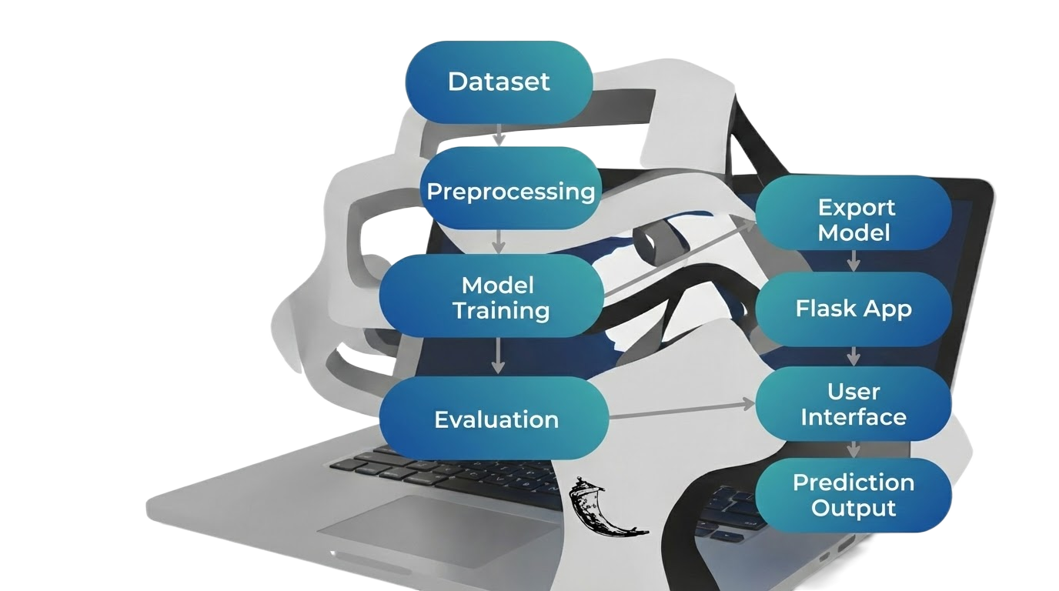
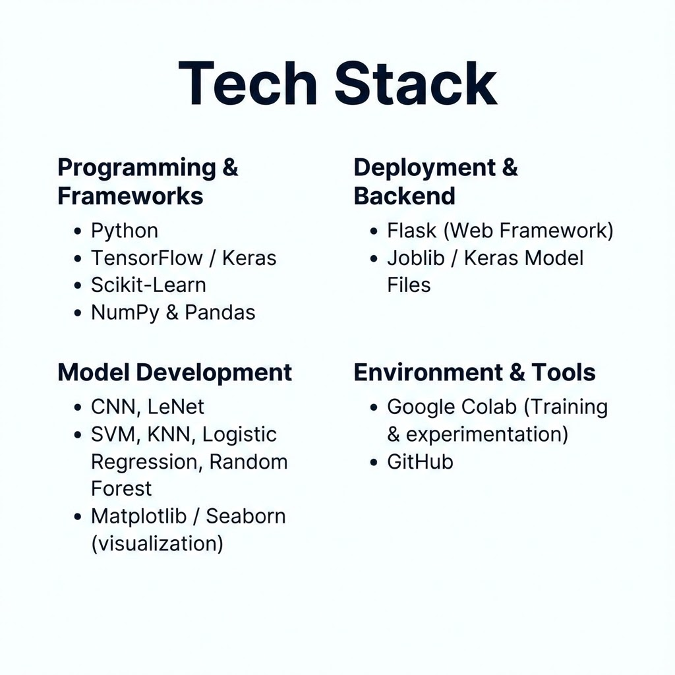

System Architecture & Tech Stack
1. Input
MNIST Dataset
Raw Images
2. Processing
Normalization
Reshaping
One-Hot Encoding
3. Modeling
Model Training
Evaluation
Export (.joblib,.keras)
4. Deployment
Flask Backend
Web Frontend
User Prediction

Slide 5
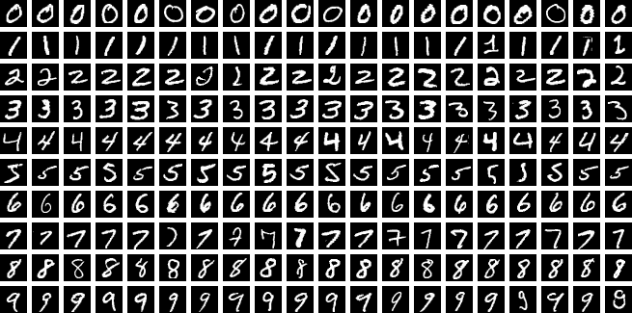
Dataset: MNIST
Properties
Source: Modified National Institute of Standards and Technology
Training Set: 60,000 labeled images
Test Set: 10,000 labeled images
Resolution: 28 x 28 pixels
Format: Grayscale (0-255 intensity)

Slide 6
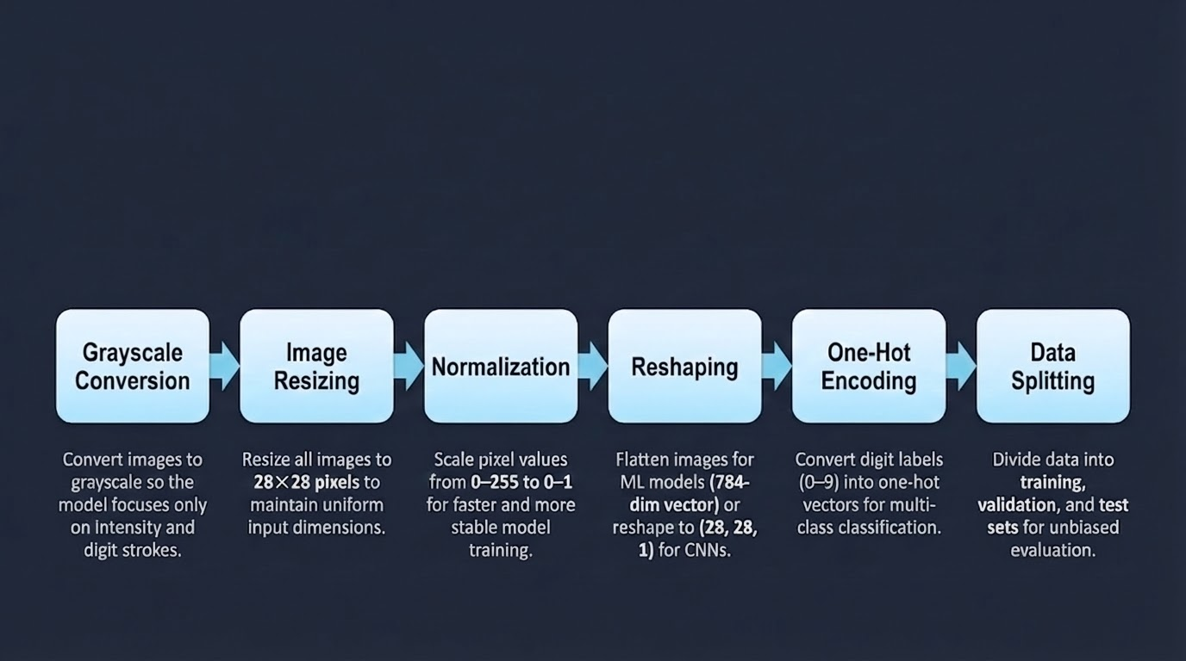
Preprocessing Steps
•
Raw images must be transformed before feeding them into models.
Raw images must be transformed before feeding them into models.

Slide 7
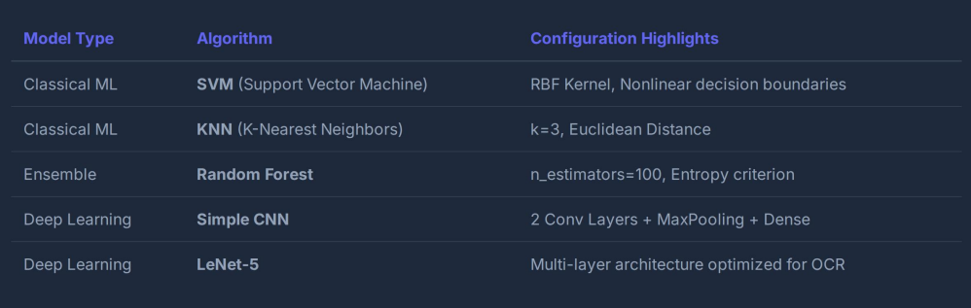
Models Implemented
250

Slide 8
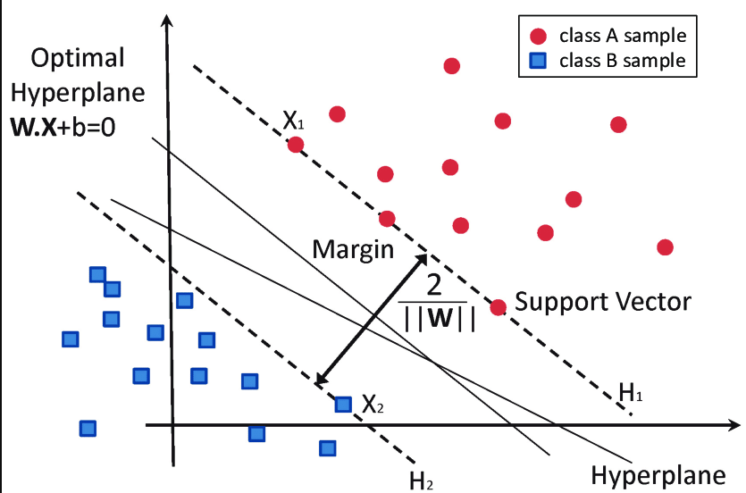
SVM: How It Works
Finds the optimal hyperplane that separates digit classes with maximum margin.
Uses support vectors to define the most critical decision boundaries.
Classifies samples based on their distance from the separating hyperplane.
Why SVM?
Effective in high-dimensional spaces (like flattened 784-pixel vectors).
Uses the RBF Kernel to handle non-linear relationships between pixclassesel intensities and digit .
Achieves strong accuracy on medium-sized datasets like MNIST.

Slide 9
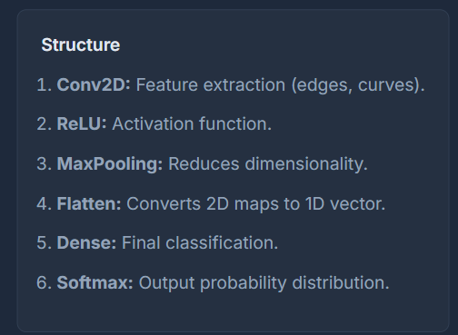

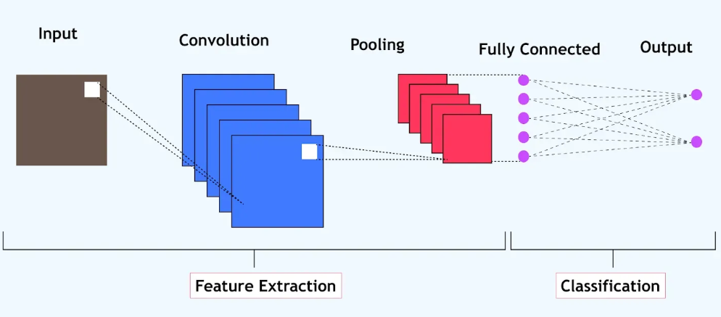
CNN Architecture (Simple)
Structure
Conv2D: Feature extraction (edges, curves).
ReLU: Activation function.
MaxPooling: Reduces dimensionality.
Flatten: Converts 2D maps to 1D vector.
Dense: Final classification.
Softmax: Output probability distribution.

Slide 10
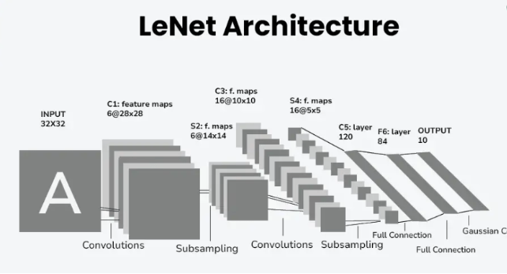
LeNet-5 Architecture
A pioneering CNN designed by Yann LeCun specifically for handwritten character recognition.
Layers Config:
•
C1: Convolution (6 filters, 5x5)
•
S2: Average Pooling
•
C3: Convolution (16 filters)
•
S4: Average Pooling
•
C5: Fully Connected (120 nodes)
•
F6: Fully Connected (84 nodes)
•
Output: 10 Classes (0-9)
Source : Geeks For Geeks

Slide 11
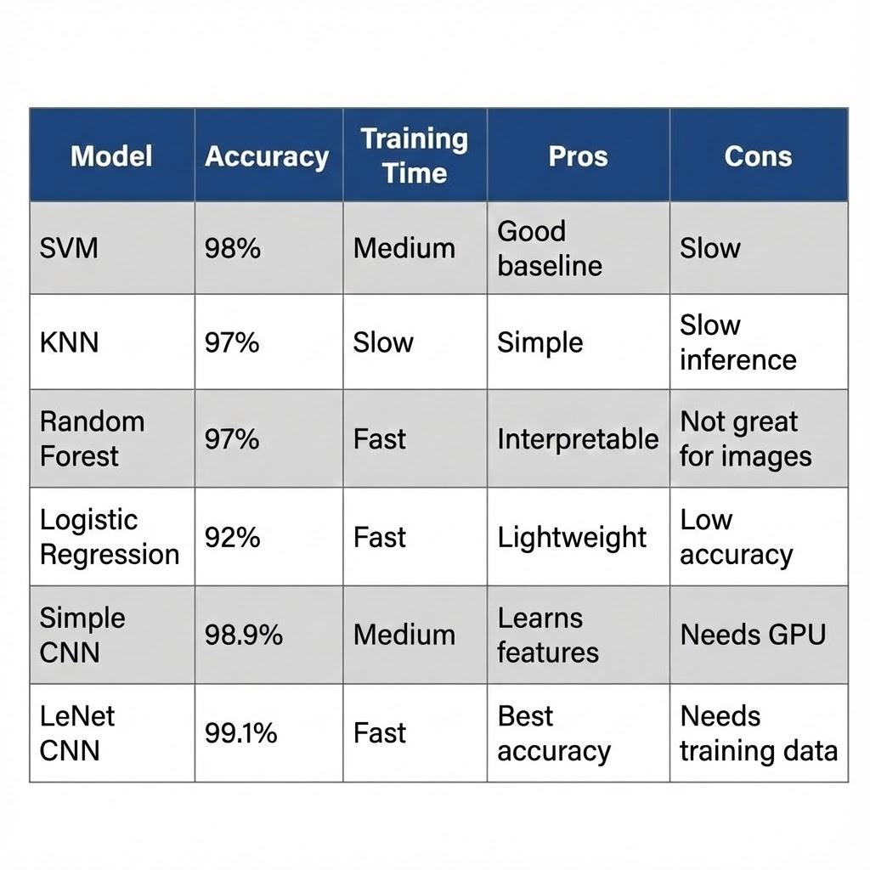
Model Comparison Results

Slide 12

Why CNN Performs Better?
Feature Extraction:
Unlike SVM/KNN which treat pixels as a flat list, CNNs automatically learn filters to detect spatial features like loops, lines, and curves.
Spatial Invariance:
CNNs recognize digits even when shifted, rotated, or slightly distorted due to convolution and pooling operations.
Hierarchical Learning:
Lower layers capture edges, while deeper layers learn complex digit shapes, improving accuracy on handwritten inputs.
Reduced Manual Effort:
No need for handcrafted features; CNNs learn patterns directly from raw pixel data.

Slide 13
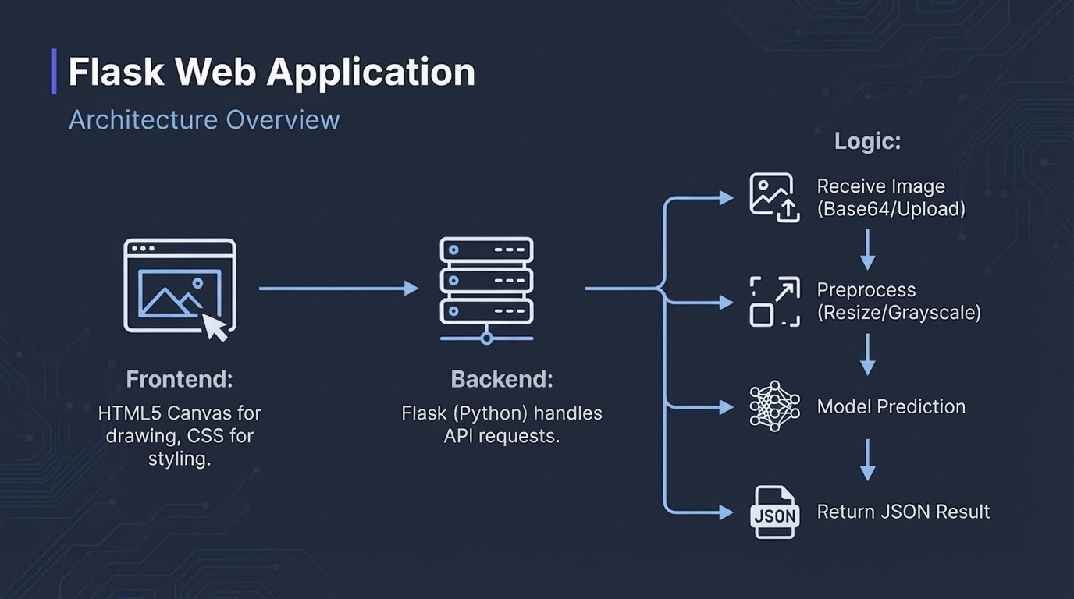

Slide 14

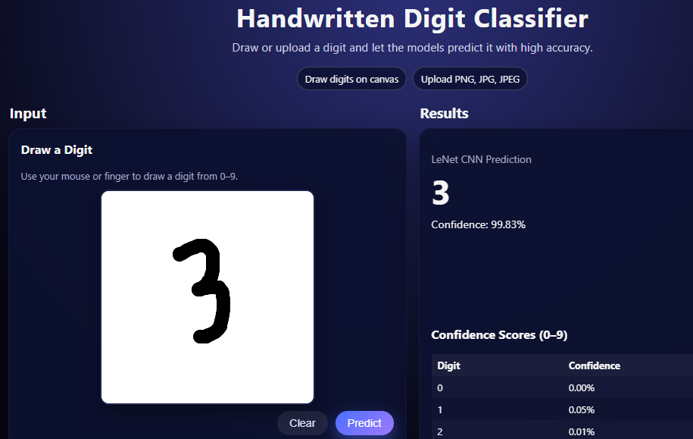

Application Interface
Key Features
•
Real-time drawing canvas
•
Image file upload support
•
Instant prediction display
•
Confidence probability score
•
Clean and Simple UI

Slide 15
Project Results
Key Achievements
Performance Highlights
99% Test Accuracy achieved using the LeNet-5 CNN model.
Outperforms classical ML models like SVM, KNN, Logistic Regression, and Random Forest.
Stable training curves with minimal overfitting.
High confidence predictions due to hierarchical feature learning.
Successfully built full ML pipeline from scratch.
Web app makes predictions in < 200ms.
Robust performance on user-drawn digits.
Seamless integration of Information Retrieval techniques.
End-to-end system demonstration of deep learning in digit recognition.

Slide 16

Conclusion
End-to-End Solution : Developed a complete pipeline covering preprocessing, model training, evaluation, and deployment..
Performance: Proved that Deep Learning (CNNs) vastly outperforms Classical ML for vision tasks.
Application: Delivered a functional, interactive product, not just a notebook.
High Accuracy & Real-Time Performance : Achieved 99% test accuracy with LeNet-5 and real-time predictions through the Flask web app.
Skills: Integrated Python, TensorFlow, and Web Development.

Slide 17

Ask here!
Project Repo

